Slide 1
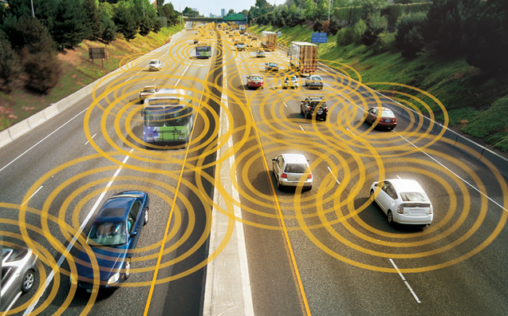
Intelligent Vehicular Accident Prevention System
Supervisor:
Dr Imtiaz Alam
Group Members:
Abdul Qadir Shahbaz 01-133122-001
Muhammad Waqas 01-133122-071

Slide 2
Agenda
Introduction
Problem Statement
Objectives
Methodology
Components Used
Block Diagram
Interfacing with Arduino
Applications & Benefits
Future Enhancement
Conclusion

Slide 3
Introduction
To design a system that can sense accidental condition by communicating other vehicle.
This system is capable of generating warning and insure safety by automatically applying brakes in a critical condition.
Convenient and accident free travelling is possible

Slide 4
Problem Statement
According to WHO 1.2 million people die in road accident every year. Up till now there is no system present which warn you before collision on places like blind spot, suddenly changing lane and on critical distance.

Slide 5
Objectives
To design a system that
Generate warning on critical distance
Maintain a safe distance
Generate warning on over speeding
Apply auto brakes

Slide 6
Methodology
Distance
Using distance formula
Communication
Automatic brakes
Automation
V2V
Distance Calculation
Duplex
Least distance and high speed

Slide 7
Distance Calculation (Approach#01)
Other vehicle should also equipped with same system
Through GPS co-ordinates are read
NRF is used to transmit co-ordinates to other vehicle
Using “Distance formula” distance of both vehicles are calculate

Slide 8
Distance Calculation (Approach#02)
Stand alone approach
Calculating the distance from sensor values
D1 representing the distance from sensor on LCD

Slide 9
Communication
Ad-hoc network is responsible for V2V communication
Network is Ad-hoc as it do not rely on pre existing infrastructure
A kind of artificial intelligence that helps vehicles to behave in intelligent manners during vehicle-to-vehicle collisions, accidents
Using NRF Ad-hoc network is established

Slide 10
Automation
Brakes are applied automatically
PWM interfacing with Arduino
DC motor interfacing with Arduino
Controlling speed of motor

Slide 12
Components Used
Arduino Mega 2560
GPS Module SKM 53
Ultrasonic Sensor HC-SR04
NRF Sensor 24L01
Modular Robotic Vehicle
LCD 16X4
H-Bridge L298H
PWM
DC Motors
Variable Power Supply
Buzzer

Slide 13
Block Diagram
LCD
Arduino
Ultrasonic Sensor
Power supply
GPS
NRF

Slide 14
Interfacing with Arduino MEGA 2560
GPS
NRF sensor
Ultrasonic sensor
LCD
PWM

Slide 15

START
GPS coordinates
Warning
NO
S>50||D<40
S<=40 && D>100
NO
Violation
Safe
Auto Brakes
NO
S<=50||D<=100
END

Slide 16

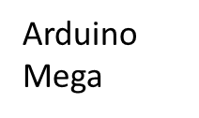

Automation
Supply Unit
PWM/
Robotic car
Distance Measuring
DC 5V,9V
Control Unit
GPS/
Distance Formula
Communication
NRF 24l01

Slide 17
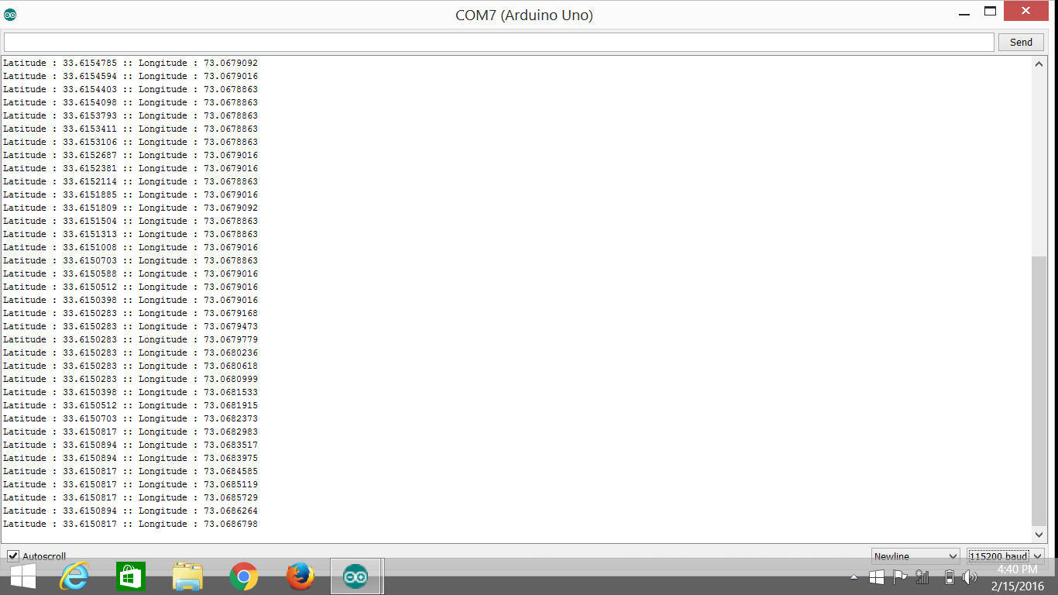
GPS Coordinates Check on Serial monitor Screen

Slide 18
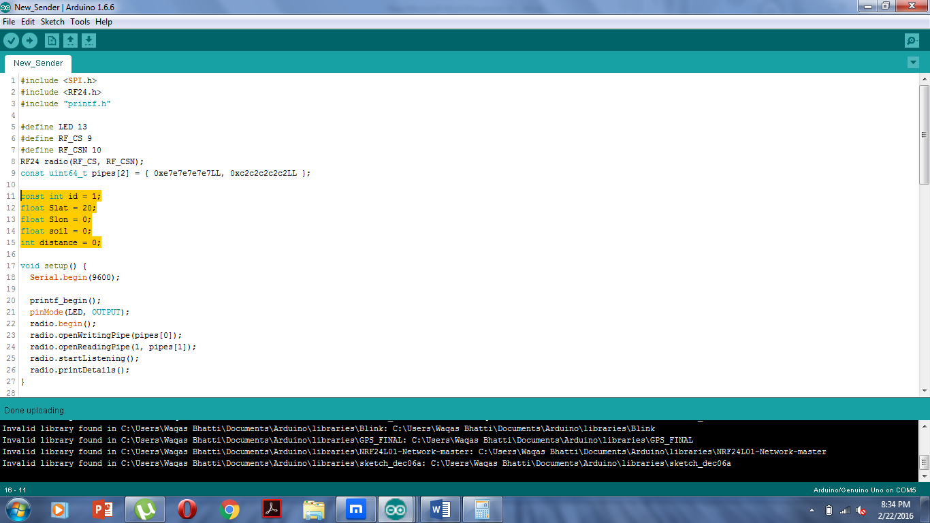
Test for NRF
Sender Side

Slide 19
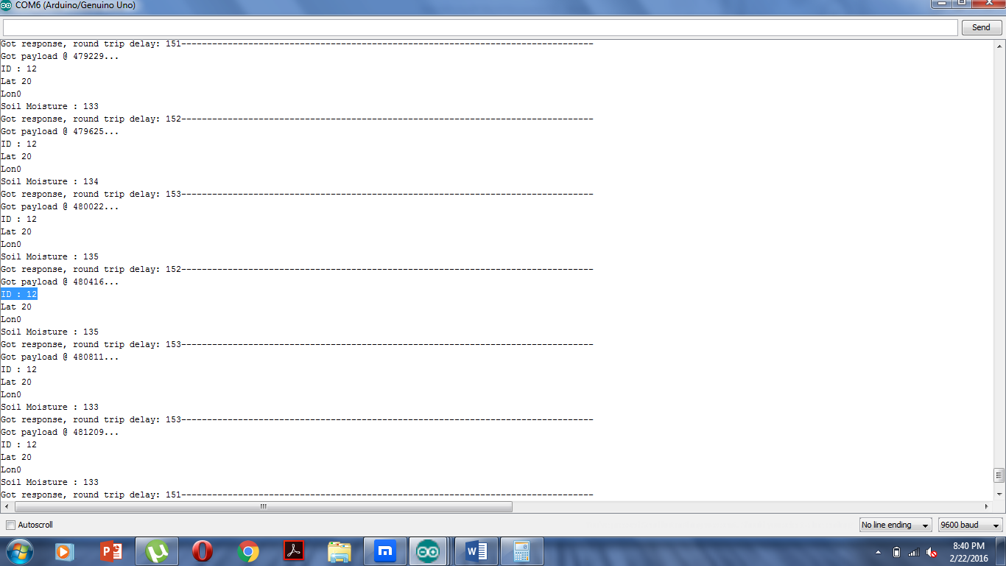
Receiver Side

Slide 20
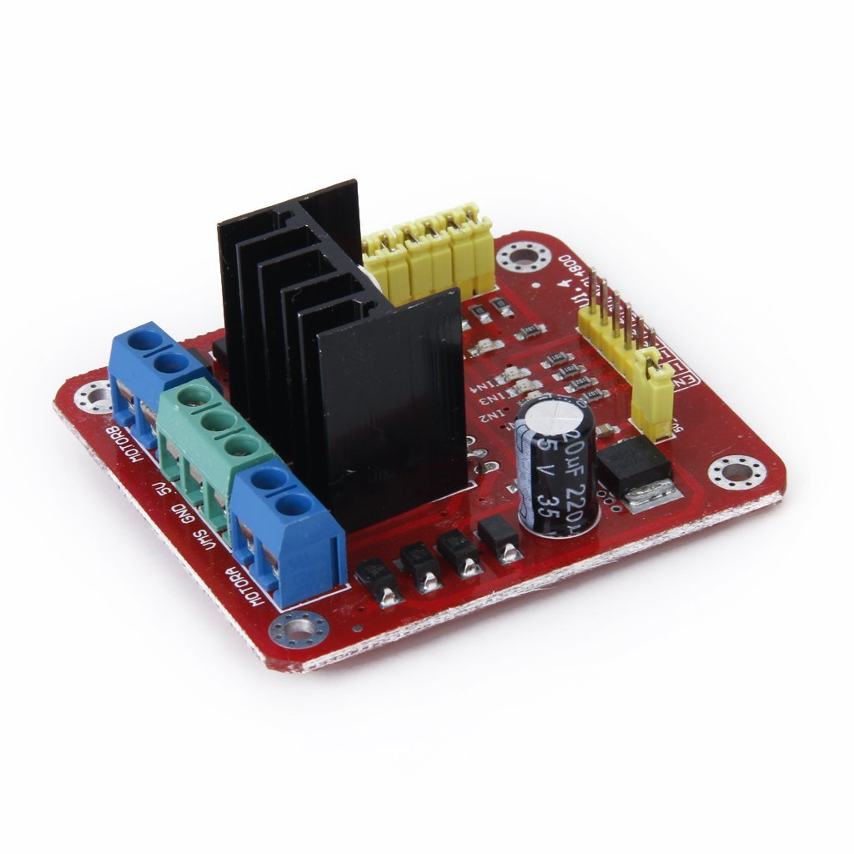
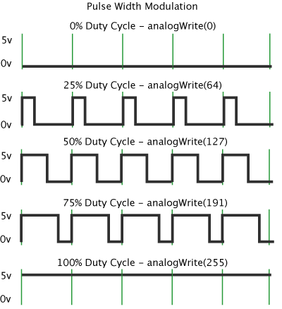
Pulse width Modulation (PWM)
PWM circuit Board
Duty Cycle wave representation

Slide 21
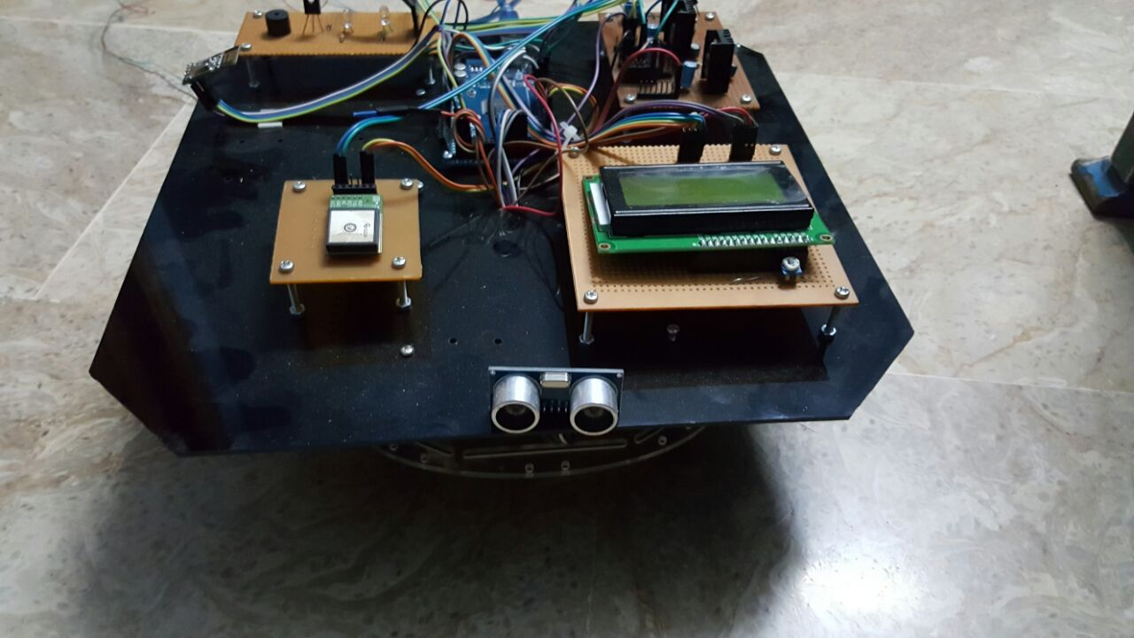
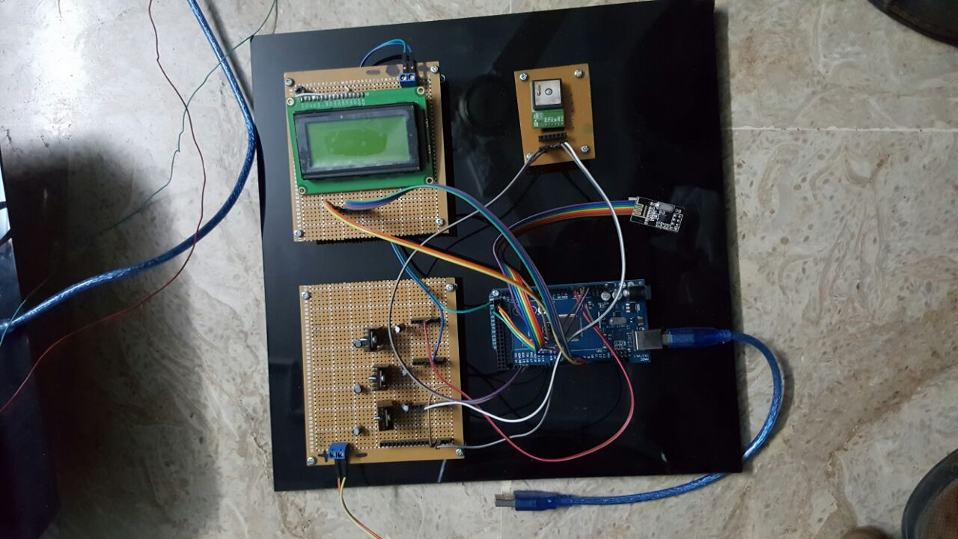
Implemented Module
Master (Vehicle 01)
Slave (Vehicle 02)

Slide 22
Applications & Benefits
Reduce the traffic congestion
Less chances of accident etc.

Slide 23
Future Enhancement
Lane detection
Pedestrian detection
Road signal detection

Slide 24
Conclusion
V2V communication is implemented successfully. Our vehicle is intelligent enough to generate warning before potential crash. System not depend on driver only as humans have greater tendency of error as compare to machines. Brakes are applied automatically on critical distance a step toward autonomous car.

Slide 25
Q/A

Slide 26
Thank You

