Slide 1

WECOME
Here you can add something in brief as the explanation, this is a demo text
Bahria university, Islamabad campus
Mid-term presentation
Exoskeleton-based Hand Rehabilitation for Post-stroke Motor Recovery
1

Slide 2
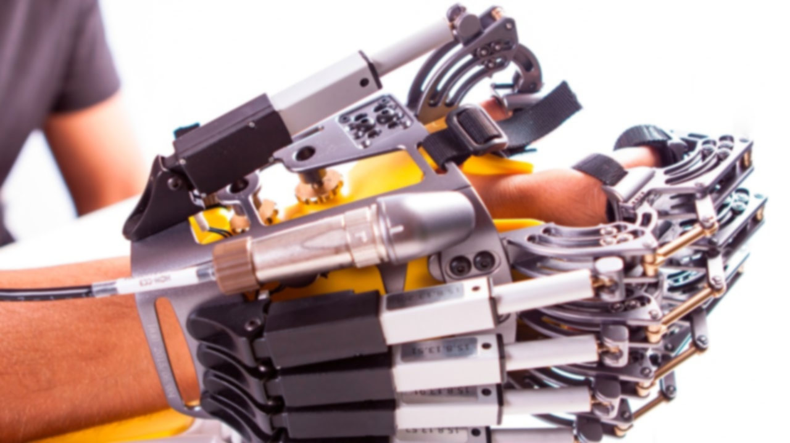
Exoskeleton-based Hand Rehabilitation for Post-stroke Motor Recovery
Supervised by: Engr. Nadia Imran
Project by: Muhammad Arslan, Ahmad Bilal, Sharjeel Ashraf
2

Slide 3
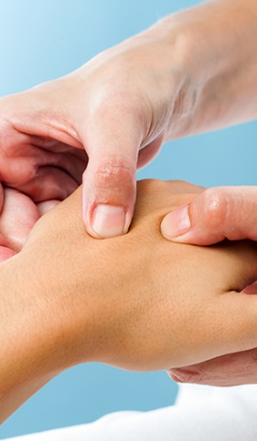
Problem Statement
Stroke patients left with impairments [1]
Physiotherapy equipment are expensive and not accessible to everyone
1
3
Rehabilitation is extremely slow and tedious via traditional methods [2]
Physical supervision of medical professional required
2
4

Slide 4
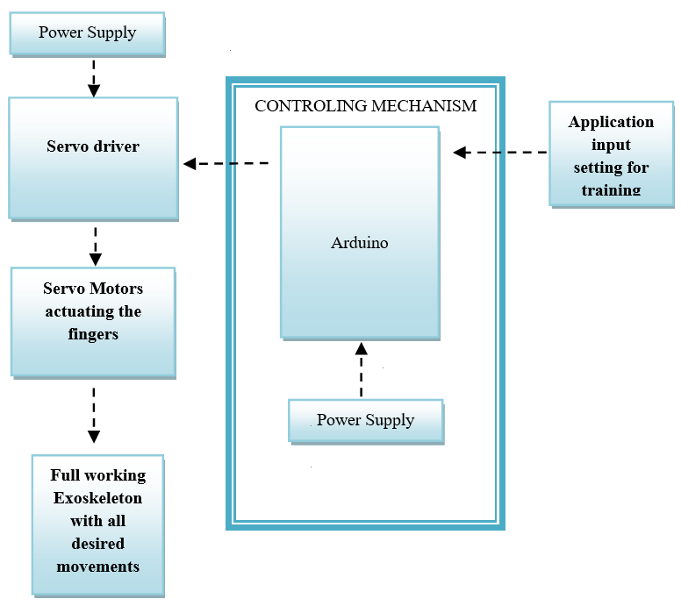
Block Diagram
Overall calibration of the system

Slide 5
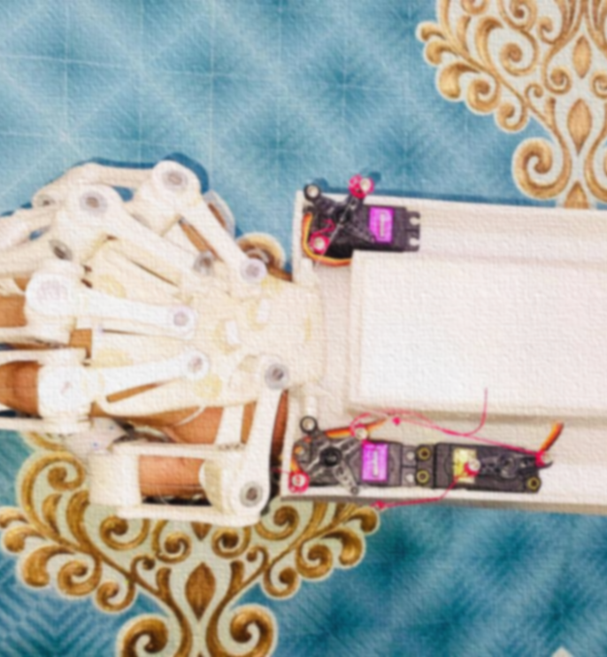
Implementation details
Exoskeleton is actuated using fishing threads
with help of servo motors
Controlled by Arduino
3D concept
Controlled Actuation
Concept developed on cardboard
1
Model controlled using Arduino
2
3D modeling and printing
Exoskeleton Assembly
3
Model Assembled
4
3D printed the model
Control Unit
GUI
Exoskeleton performs finger movements
5
GUI integrated and able to provide training
6

Slide 6
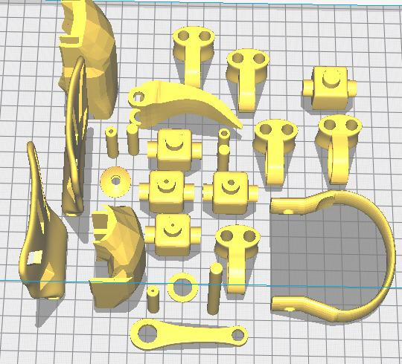
3D-Printed model
The exoskeleton device is printed using polylactic acid and thermoplastic polyurethane material
SLT Files on 3D print board

Slide 7
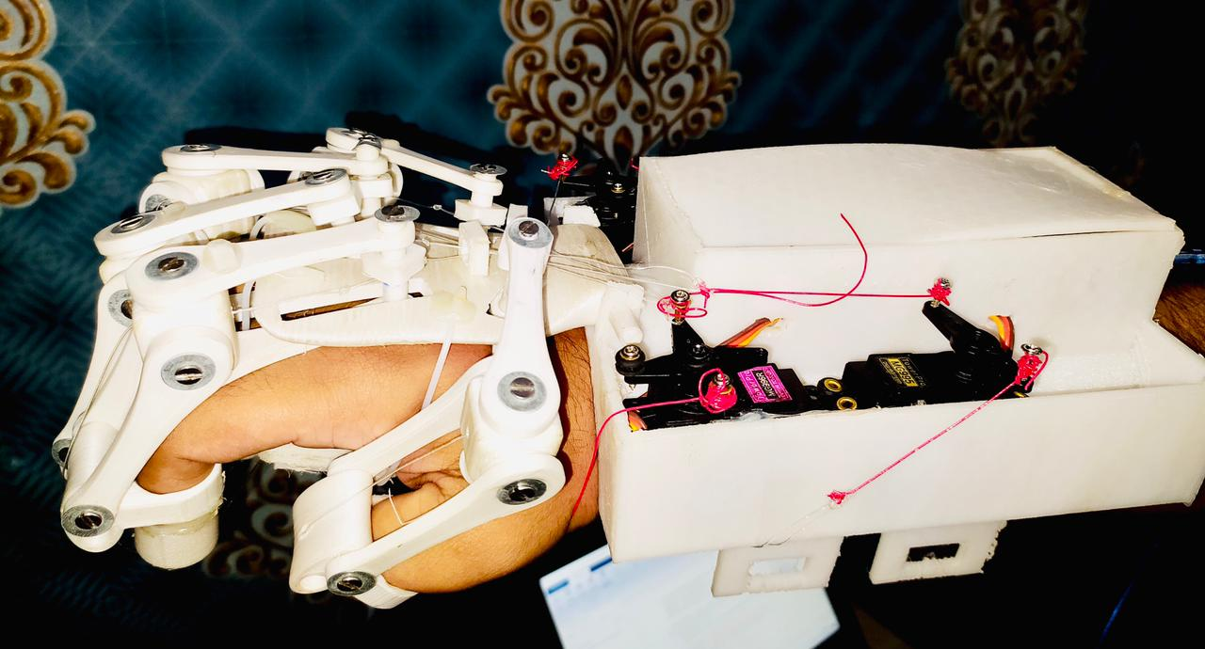
Exoskeleton Model Assembled

Slide 8
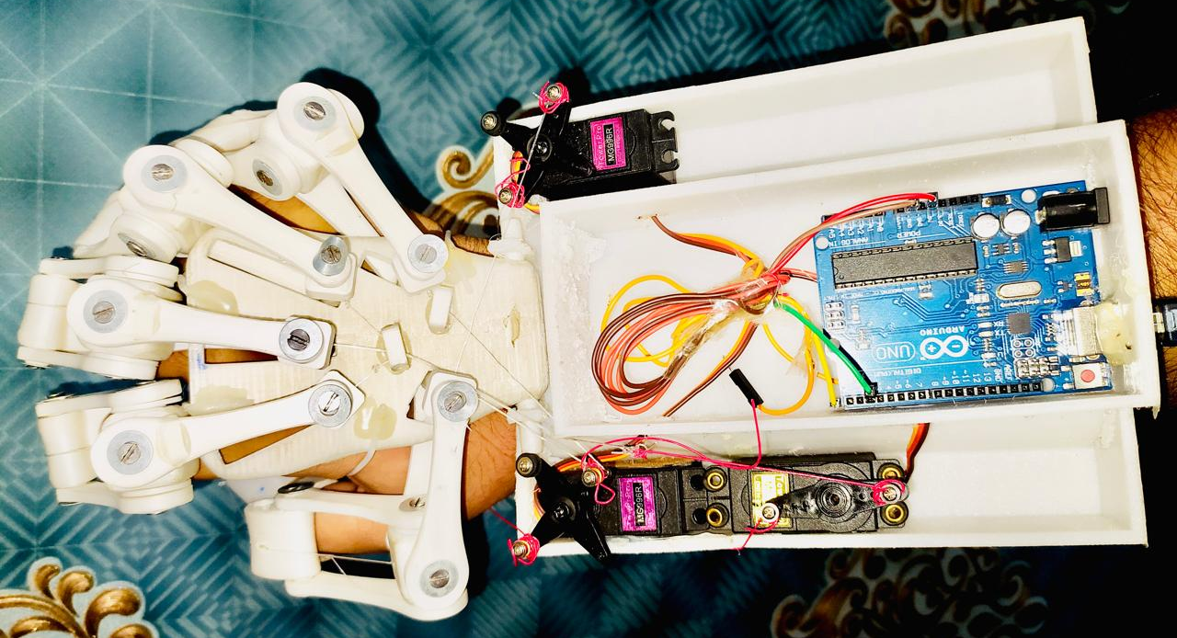
Exoskeleton Model Assembled (Top View)

Slide 9
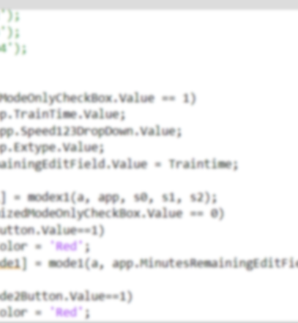
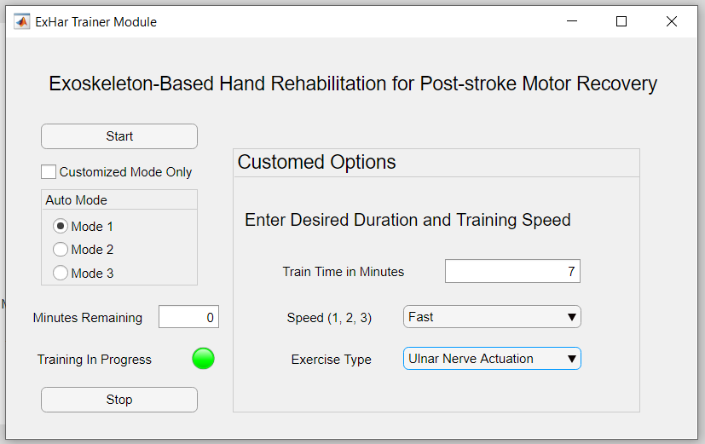
Graphical User Interface
Desktop App
Easy-to-Use Application to control the device
1
Auto and Manual Training
Cab train hand in auto and customized modes
2

Slide 11
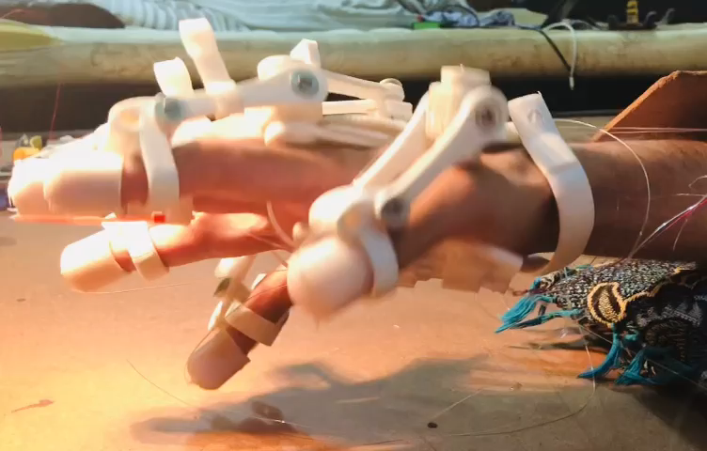
Median nerve
training &
rehabilitation
Exercise 1

Slide 12
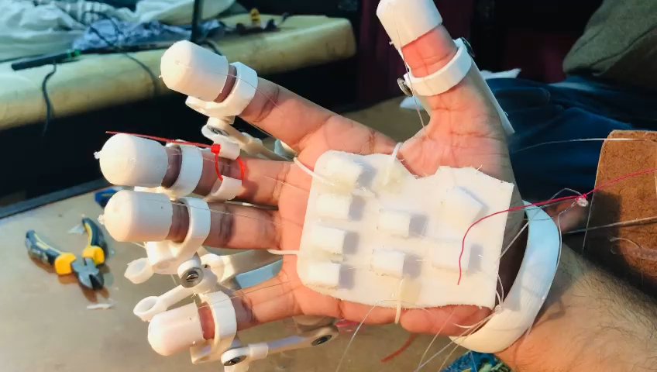
Radial & Ulnar nerves rehabilitation
Exercise 2

Slide 13
Our Timeline
The timeline we have followed the project and to continue
Cardboard model
actuation
March 20th
Jan 8th
Remaining Servobox
printing & assembly
3D modeling
and simulation
April 20th
Application and
Input interface
Jan 20th
3D printing and testing
Feb 10th
Complete working Exoskeleton
May 20th
March 1st
Design assembly
and actuation
June 1st
Final Presentation

Slide 14
Conclusions
1
Stroke patients paralyzed
Current methods costly and tedious
2
3D-Printed exoskeleton
3D-printed hand exoskeleton actuating fingers & training
Final Prototype
3
We have presented the final prototype of our project

Slide 15
References
1. GBD Mortality and Causes of Death Collaborators, “Global, regional, and national age–sex specific all-cause and cause-specific mortality for 240 causes of death,1990–2013: A systematic analysis for the global burden of disease study 2013,” Lancet, vol. 385, no. 9963, pp. 117–171, 2015.
02. C. E. Lang and J. A. Beebe, “Relating movement control at 9 upper extremity segments to loss of hand function in people with chronic hemiparesis,” Neurorehabil Neural Repair, vol. 21, no. 3, pp. 279–292, 2007.
03. Li M, He B, Liang Z, et al. An Attention-Controlled Hand Exoskeleton for the Rehabilitation of Finger Extension and Flexion Using a Rigid-Soft Combined Mechanism. Front Neurorobot. 2019;13:34. Published 2019 May 29. doi:10.3389/fnbot.2019.00034

Slide 16

In the memory of our brother and groupmate, Muhammad Arslan
May he rest in peace

Slide 17
THANK YOU
Criticism and questions are welcome

Slide 18
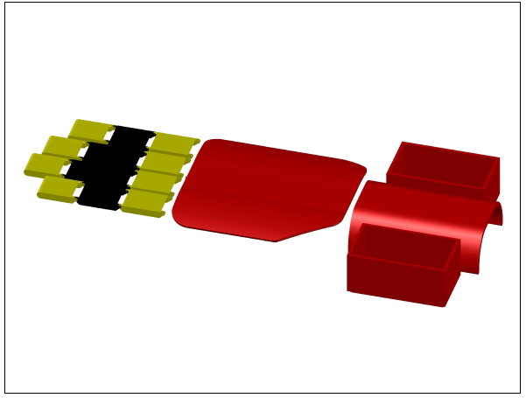
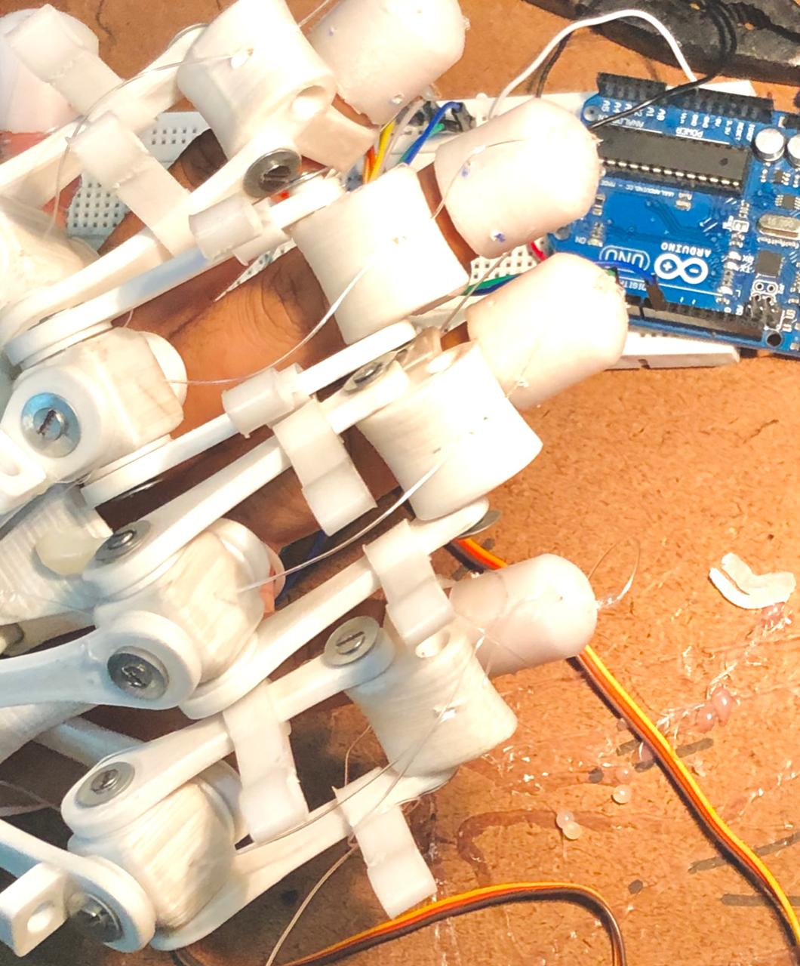
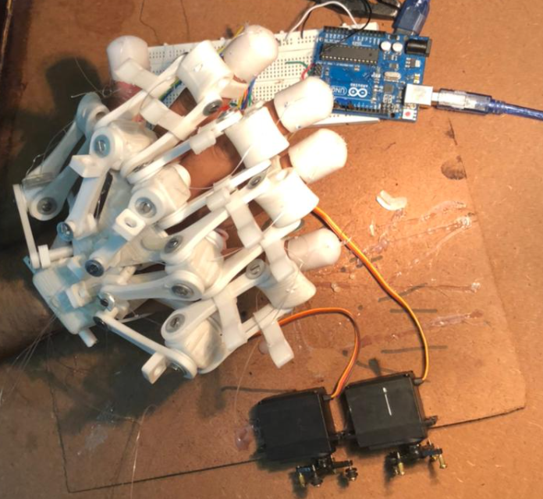
FAQ 1
FAQ 3
FAQ 2

Slide 19
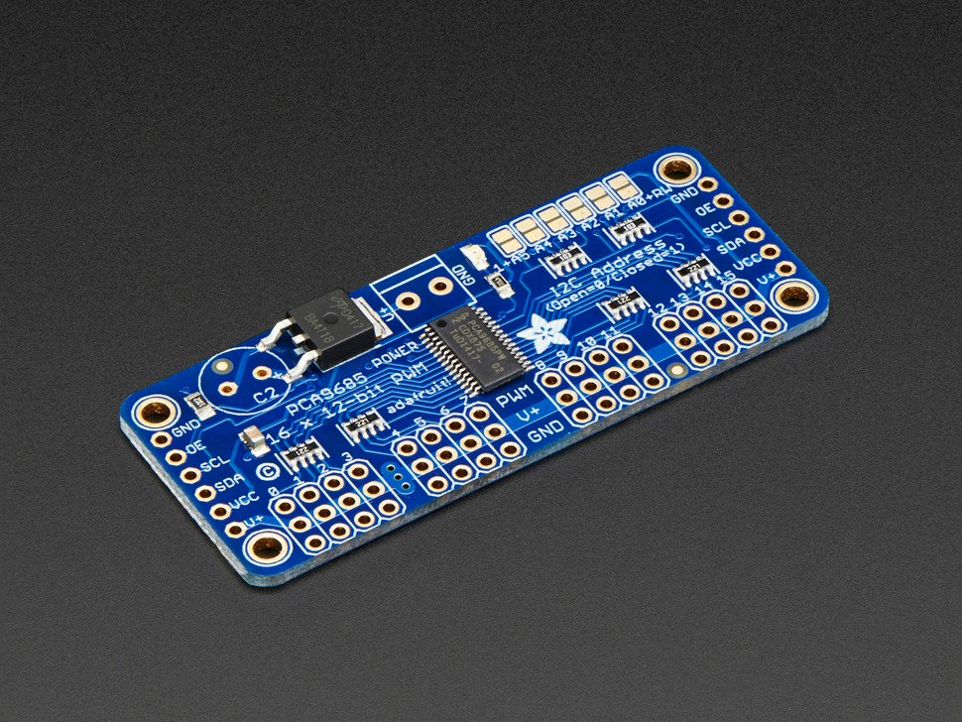
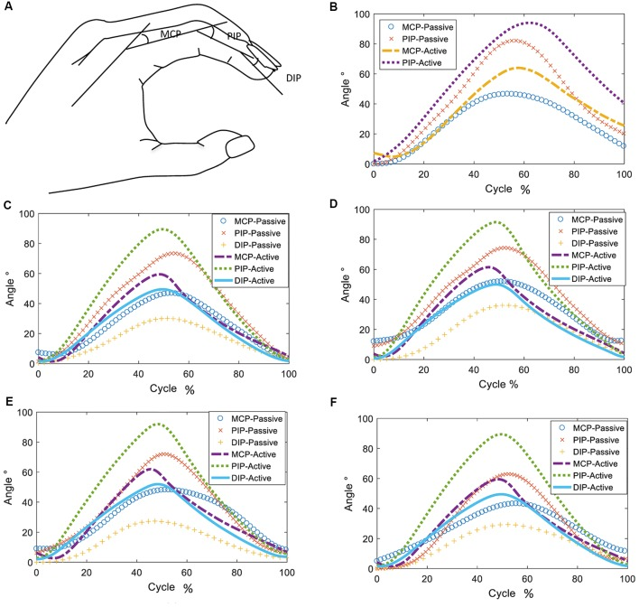
Adafruit 16-Channel 12-bit PWM/Servo Driver - I2C interface - PCA9685
4 x 1.2 Amp = 4.8 Amps at 5v = 24 watts supply
FAQ 4 [3]

